Slide 1
Effective & Enduring Use of SIG 1003(g) Funds
Presented by: Karen Suddeth
SIG Program Specialist, GaDOE
February 2018

Slide 2
History & Experience
Named Principal of “Needs Improvement – 4” High School
Test Performance & Participation (AYP)
Discipline
Attendance: Student and Teacher
Culture
No Technology
Knowledge of Requirements

Slide 3
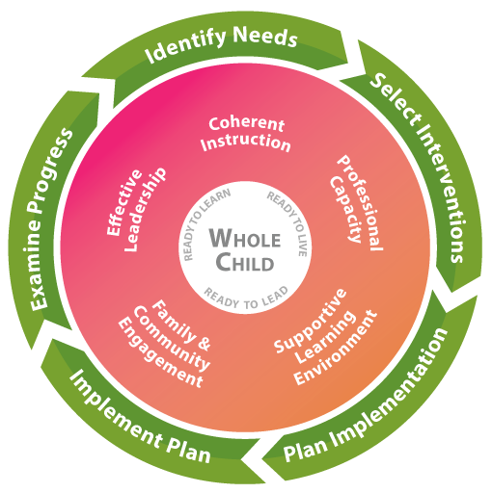
Elements of School Improvement

Slide 4
There is No Easy Fix
If it could be bought . . .
We would all have it!

Slide 5
In Fact . . .
Some would have you believe it can be purchased!

Slide 6
The School Improvement Mystery
Overall School Improvement is challenging and a one-size-fits-all approach doesn’t work.
V is for VARIABLES
E is for EACH school is different
R is for RESEARCH (Know your data)
Y is for YOUR kids deserve it
School Improvement is VERY Challenging Work
For the “Lowest Performing Schools with the Greatest Commitment to Improvement.”

Slide 7
Where to Begin
Examining data
Identifying Root Causes
Setting SMART Goals
Determining Action Steps toward Achieving Goals
Identifying Who is Responsible & Timeline – Short Term Action Plan(s)

Slide 8
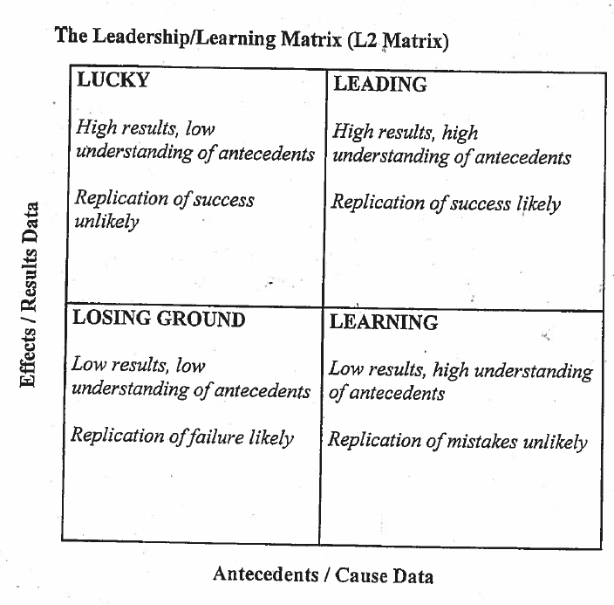
Setting a Vision
Leading the School Staff to a Vision of Success with Data Review
Source: Leadership & Learning Center – Houghton Mifflin Harcourt

Slide 9
SIG Funds Help
Technology
SIG Coordinator
Academic Coaches
Instructional Technology Coach
Family & Community Coordinator
Job Embedded Professional Learning
Other PL – AP, Gifted, Math Technology, GLISI
ILT – After School: Tutorials – Night School
ILT – Saturday School – Summer School
Academic Culture – Academic Wall of Fame

Slide 10
Job Embedded Professional Learning
Teacher Academy
Collaborative Planning
Collegial Planning
Horizontal & Vertical Planning
Math Technology PL

Slide 11
Enduring Elements
Leadership Team
Teacher Leaders
Practices and Protocols (Academic Wall of Fame, Senior Walk, Mentor Programs, Attendance Celebrations, etc.)
Collegial Planning
Horizontal & Vertical Planning
Engaging Families & Community

Slide 12
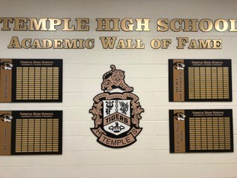
Opportunity to Develop Enduring Elements

Slide 13
Sustainability
Sustainability Plan – Leadership Team, Teacher Leaders, Enduring Elements
Planning for Personnel – Soft Landings
Hiring
Mentor Program

Slide 14
Mentor Program
One to One Pairing – Teacher to Protege
Teacher Leader to oversee
Monthly Meetings
Culture Element
Just in Time PL
Question & Answer Time

Slide 15
Maintaining a Culture of Success
School Improvement is more than a 3 year or 5 year plan
Feeder Schools
Mentor Program
Hiring

Slide 16
Questions & Comments
Contact: Karen Suddeth, SIG Program Specialist
Georgia Department of Education
Phone: 4040-656-6058

