Slide 1
Computer Science
Data+Awareness Presentation
Notes:
Computer Science education is a hot topic across the nation. CS4All is an initiative that was started in the White House and has since been taken up by a wide range of stakeholders from the National Science Foundation to various SEAs across the country. Why is this wave growing and cascading and what do we need to do to ride that wave?

Slide 2
It’s Needed
Notes:
The first driver is always a strong societal and economic need. The interest of the students and the need of the industry are also powerful drivers of this paradigm shift.

Slide 3
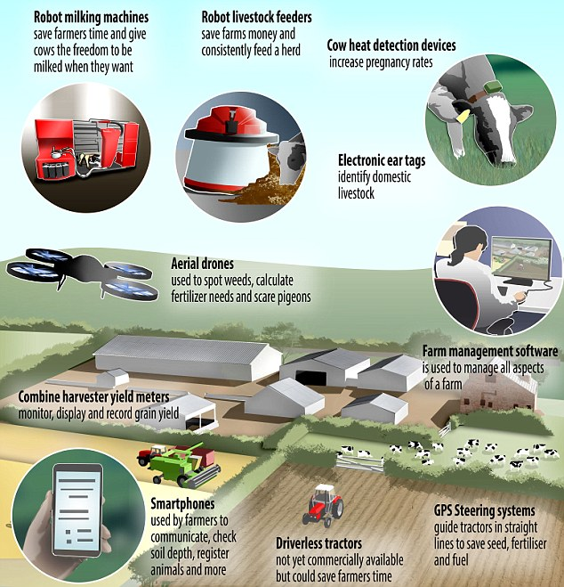
Societal Problem Solving
Many of our societies current major challenges have been identified as having potential computational solutions.
Notes:
Computational problem solving is an approach to addressing our common challenges that is employed across context.

Slide 4
Computational thinking is an approach to problem solving that builds on the problem solving strategies of the past:
Various Scientific Processes
Engineering Design Process
Analytical Thinking
Critical Thinking

Slide 5
Workforce Needs
Georgia currently has 19,314 open computing jobs (4.0 times the average demand rate in Georgia).
The average salary for a computing occupation in GA is $85,687, which is significantly higher than the average salary in the state ($45,420).
The existing open jobs alone represent a $1,654,958,718 opportunity in terms of annual salaries.
Notes:
Reference: code.org

Slide 6
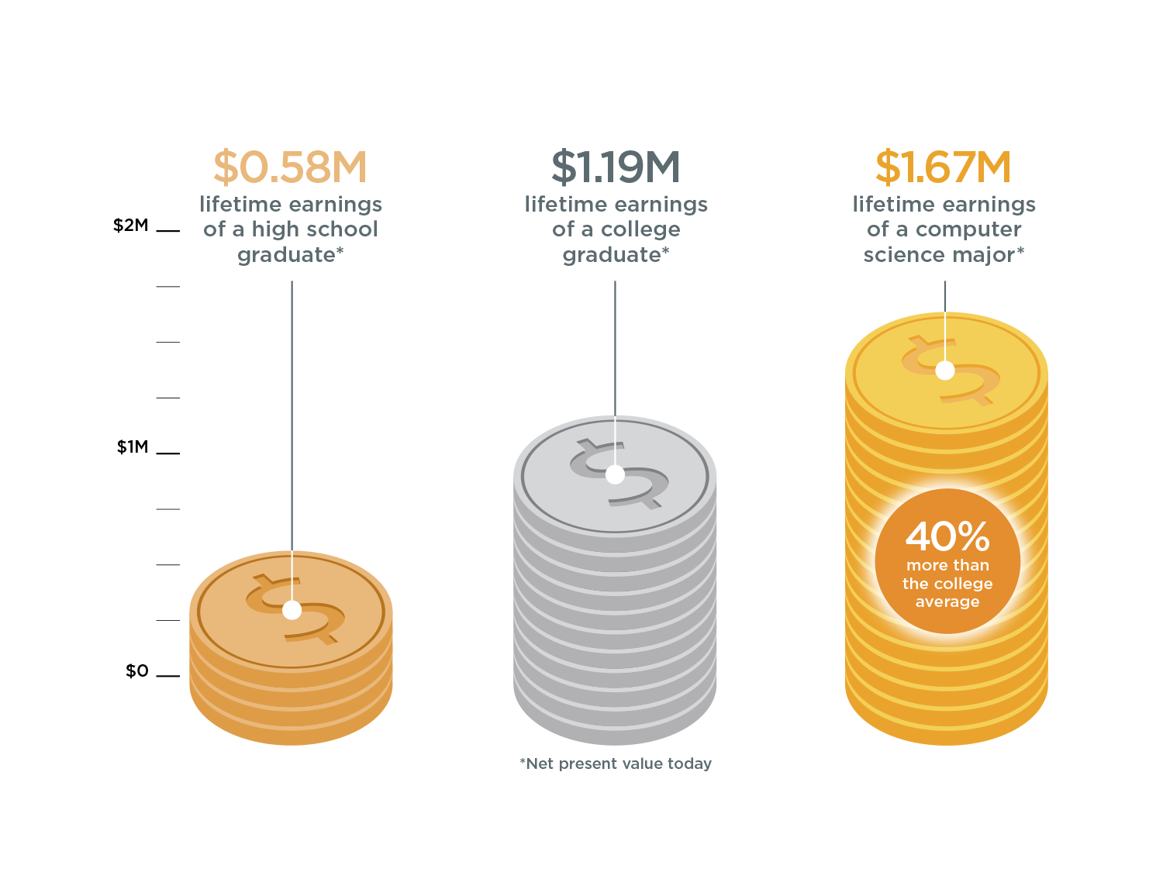
The value of a computer science education
Notes:
Reference: code.org

Slide 7
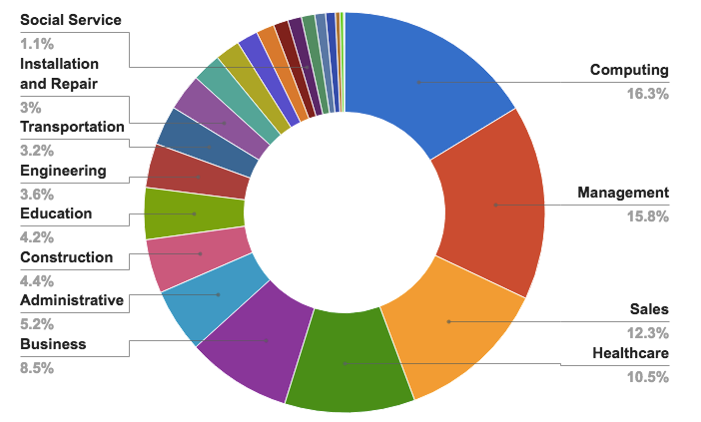
Computing jobs are the #1 source of new wages in the United States
500,000 current openings: These jobs are in every industry and every state, and they’re projected to grow at twice the rate of all other jobs.
Notes:
Reference: code.org

Slide 8
Diversity Challenge
Georgia had only 1,747 computer science graduates in 2015; only 19% were female.
African Americans and Latinos combined make up less than 19% of the U.S. engineering workforce, which includes computer science occupations, while representing over 30% of the US population (National Council for Minorities in Engineering, 2012)
Research shows that diversity leads to better decision-making (Levine and Stark, 2015), more innovation (Center for Talent Innovation, 2013) and better outcomes for businesses (Deloitte, 2012)

Slide 9
Student demographics for HS CS courses across GA 2015-2016
 |  |  | CS |  | Overall
Ethnicity: | Hispanic |  | 8.7% |  | 14.6%
Race: | American Indian |  | 0 |  | 0.2%
 | Asian |  | 0.2% |  | 3.8%
 | Black |  | 32.1% |  | 36.9%
 | Pacific Islander |  | 0.2% |  | 0.1%
 | White |  | 53.1% |  | 41.1%
 | Two or more |  | 1.6% |  | 3.4%
Gender | Female |  | 31.1% |  | 48.8%
 | Male |  | 69.0% |  | 51.2%
Notes:
The percentage of ethnic minorities and females in computer science courses is lower, in some cases much lower, than their representation in the overall school population. This disparity persists and is even exacerbated in the workforce.

Slide 10
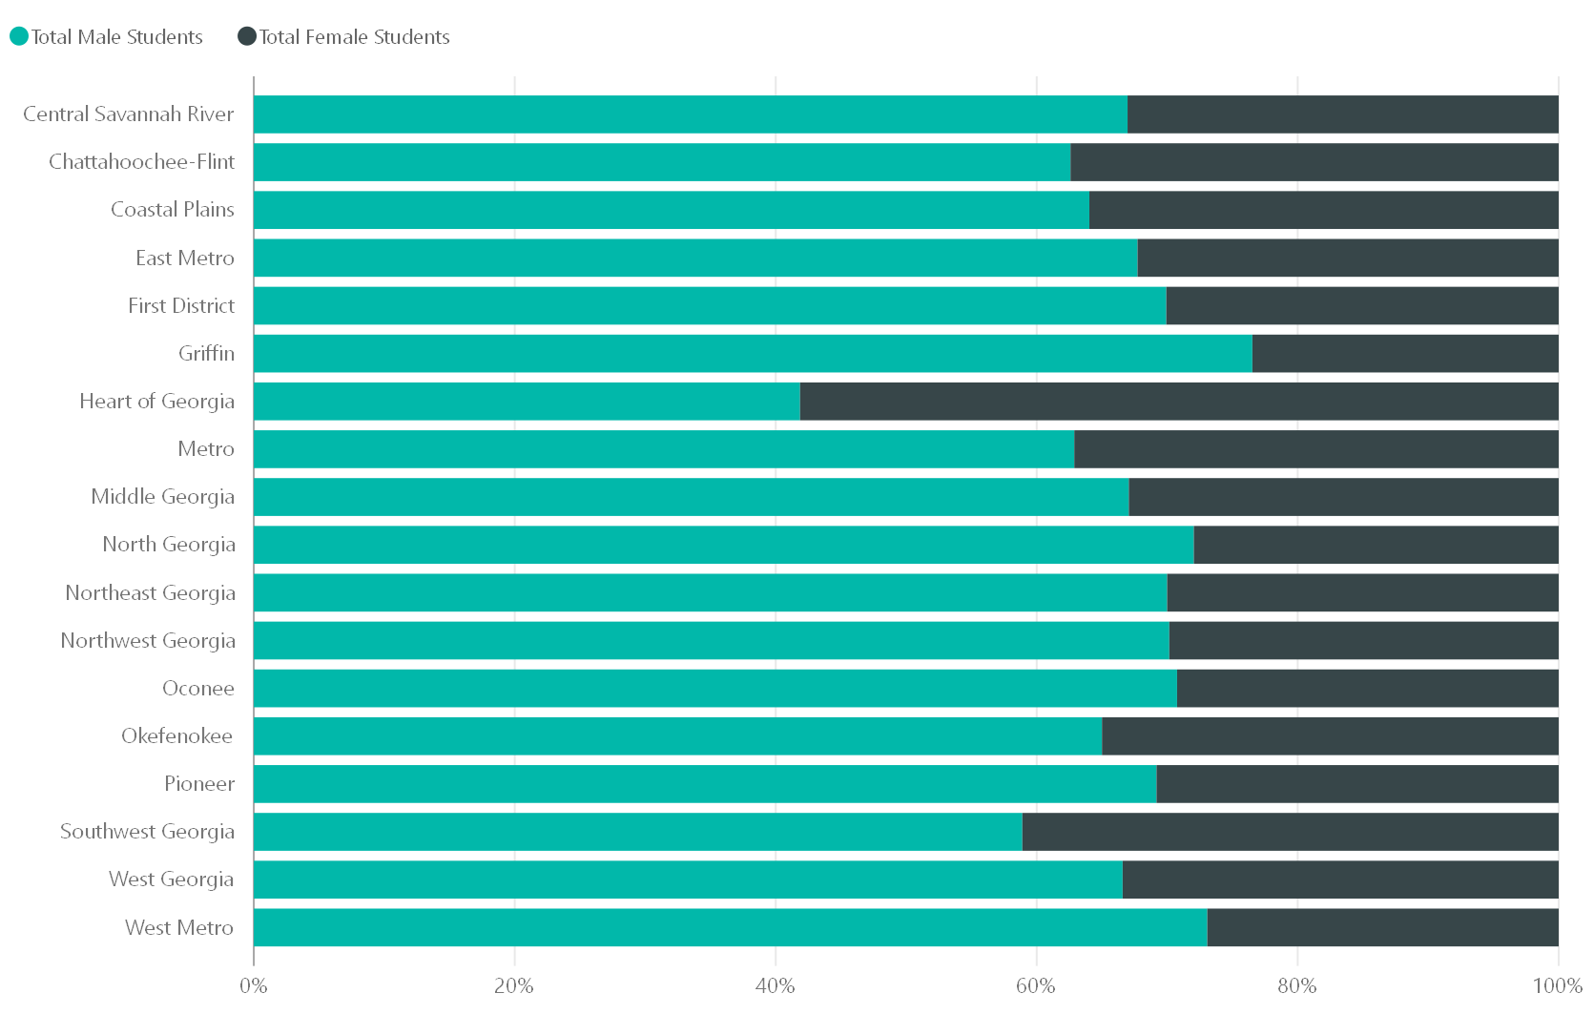
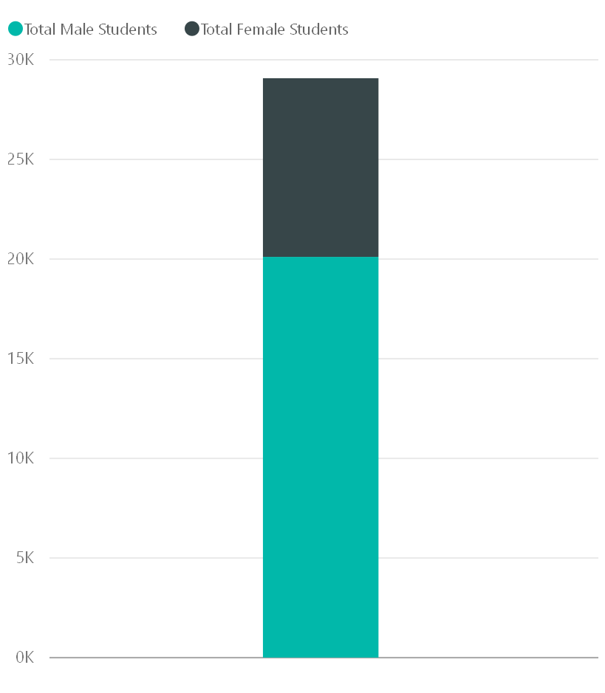
Fall 2016 CS Enrollment Male to Female Ratio

Slide 11
It’s Wanted

Slide 12
…but the majority of schools don’t teach computer science:
90%
parents want their child to study computer science
40%
of schools teach computer programming
Source: Gallup

Slide 13
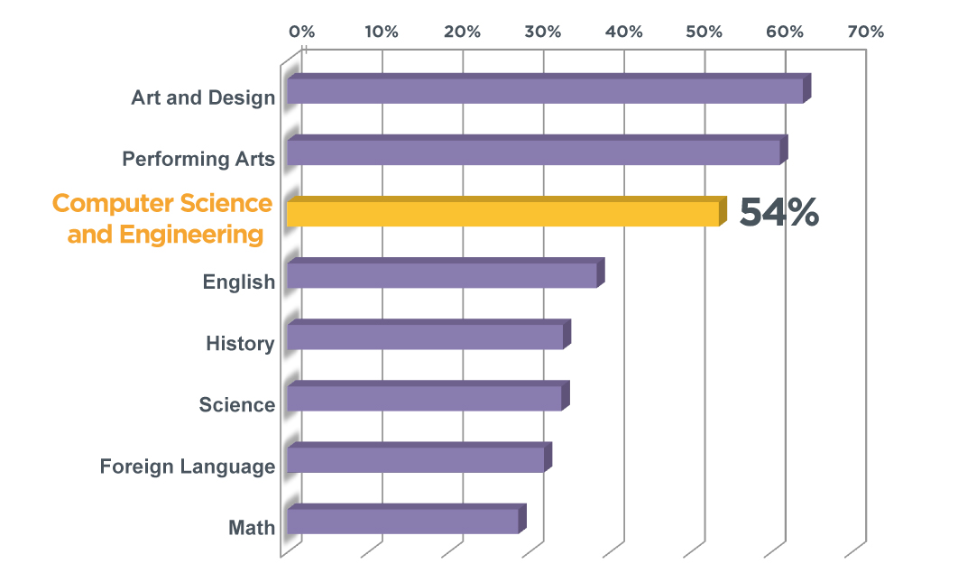
And students enjoy computer science and the arts the most
Source: Change the Equation

Slide 14
It’s Available

Slide 15
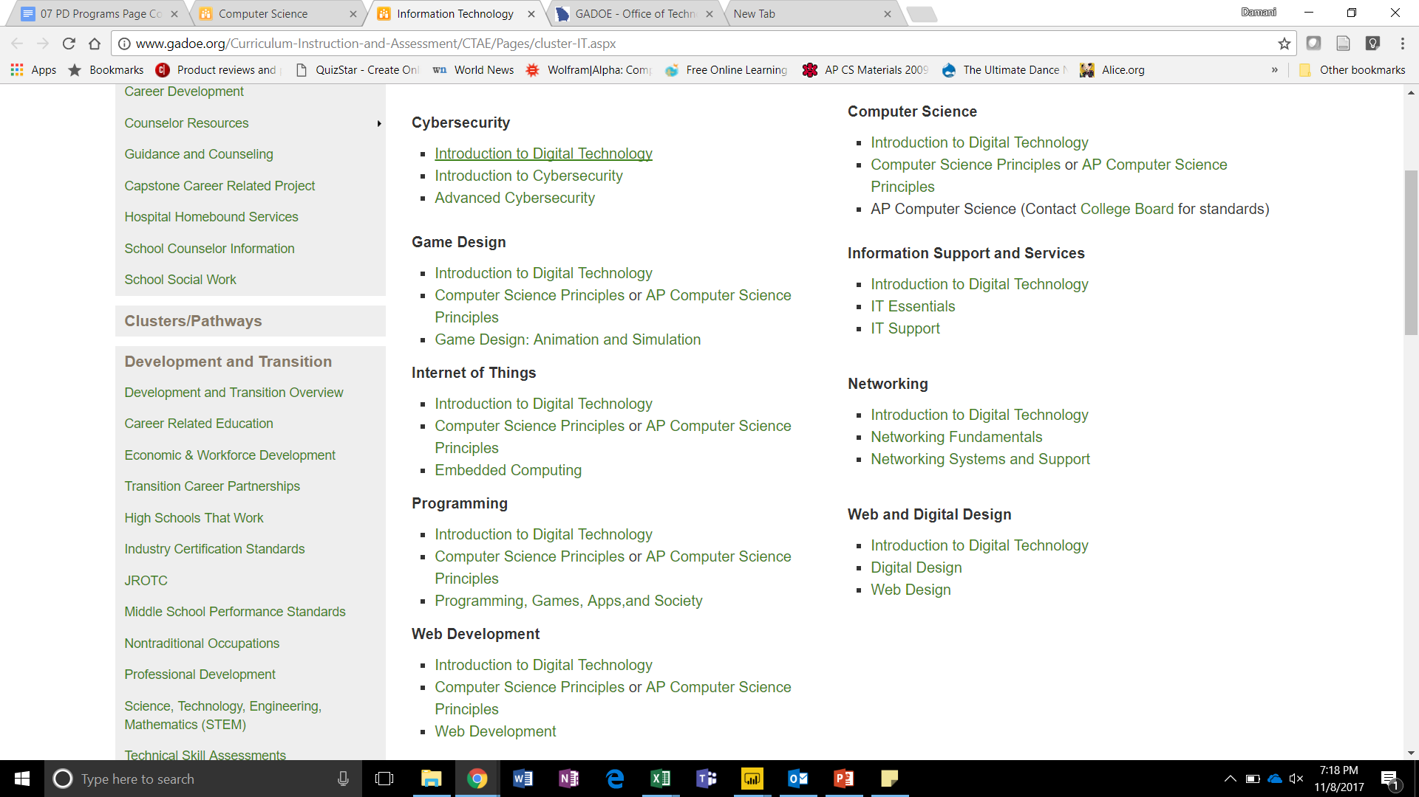
GA 2016-2017 HS CS Pathways
Notes:
These are all of the CTAE and Academic course offerings in 2017. Three related courses in a sequence constitute a CTAE pathway. Most pathways start with Introduction to Digital Technology which explains the large enrollment numbers in this course compared to the others (see charts later in the presentation). Pathways often culminate in an exam that is also an industry recognized certification.

Slide 16
Rigor and Variety
These courses may be counted as a fourth math or a fourth science credit for the purpose of graduation.
They also count for science (not math) admission requirements for USG.
A sequence of CS courses may also satisfy the foreign language entrance requirement for the University System of Georgia (ex. Computer Science Principles and AP Computer Science A)
Advanced Placement, Computer Science A
IB Computer Science, Year One
IB Computer Science, Year Two
Computer Science Principles
Programming, Games, Apps and Society
Web Development
Embedded Computing
Game Design: Animation and Simulation
AP Computer Science Principles
Notes:
These are the courses that count as a fourth credit for math, science, and foreign language.

Slide 17
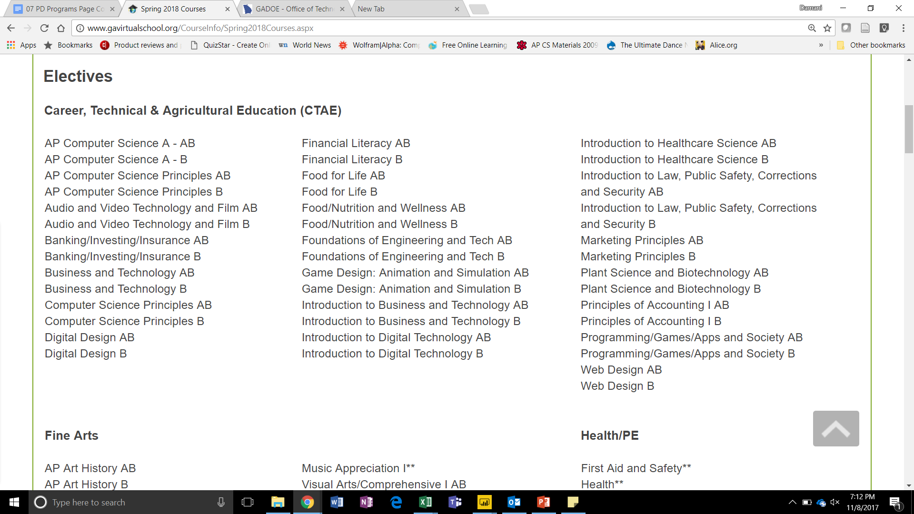
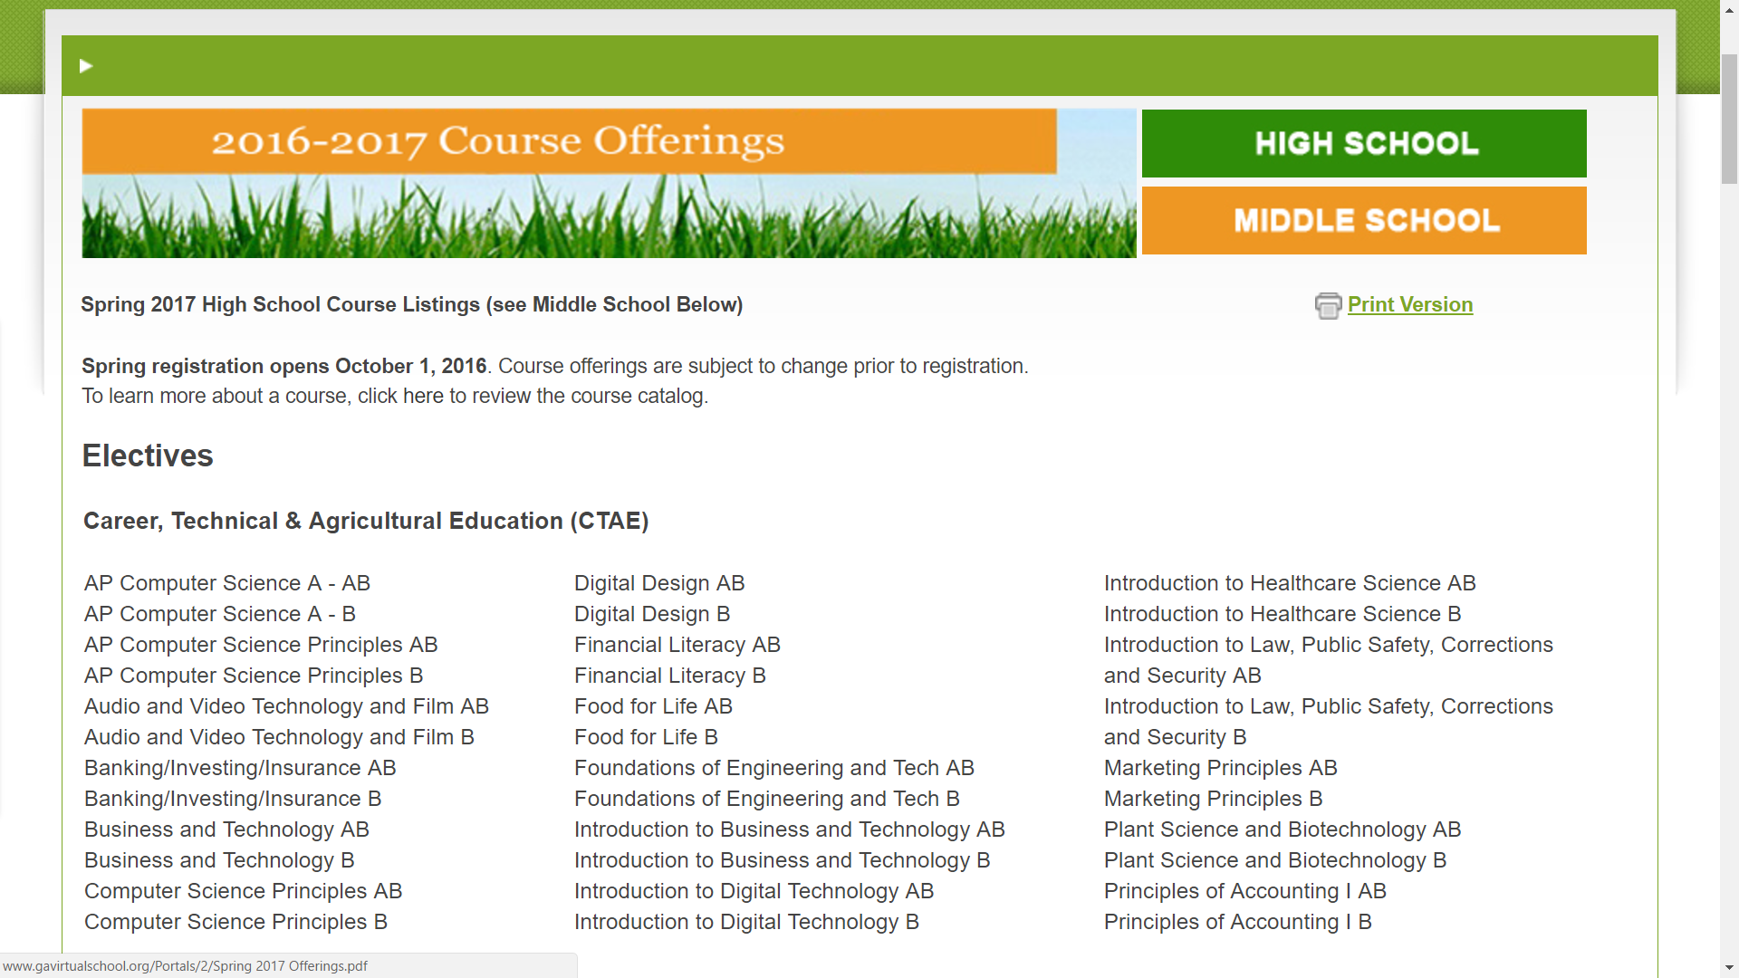
GAVS offers several high school computer science courses online for all students in Georgia.
More courses are being developed
Schools that don’t have a CS teacher can still offer courses via this online platform.
New computer science teachers can also utilize the GAVS curriculum as a backdrop for their class

Slide 18
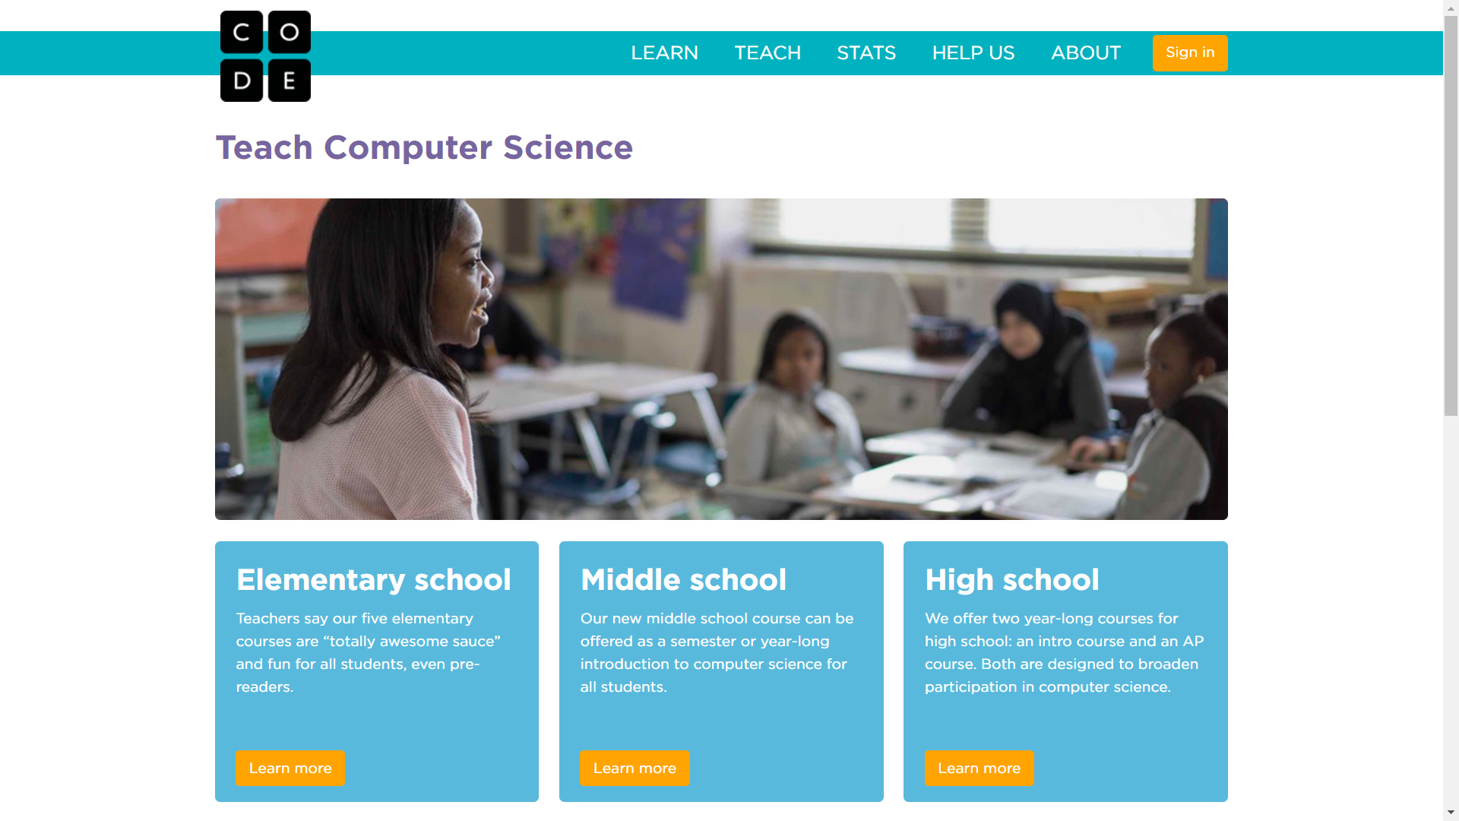
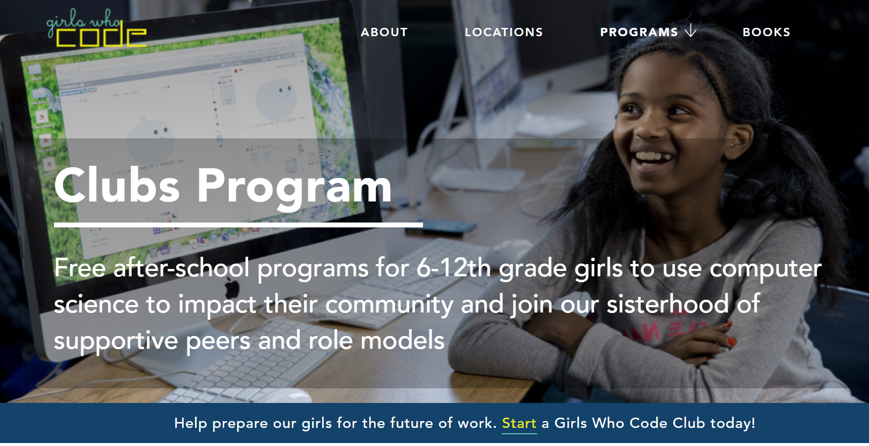
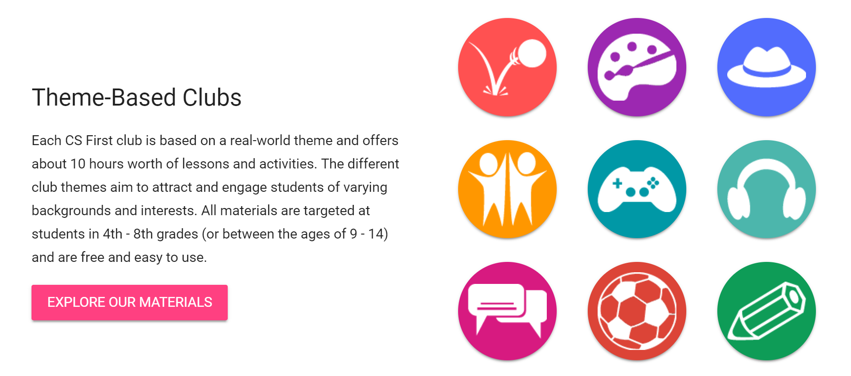
Many K12 Curricula Exist
Notes:
Code.org, girls who code, CSFirst and Khan Academy are just a few of the myriad of curriculum choices that offer CS. CS Unplugged offers computing and computational thinking lessons that don’t require a computing device.

Slide 19
Enrollment is Growing

Slide 20
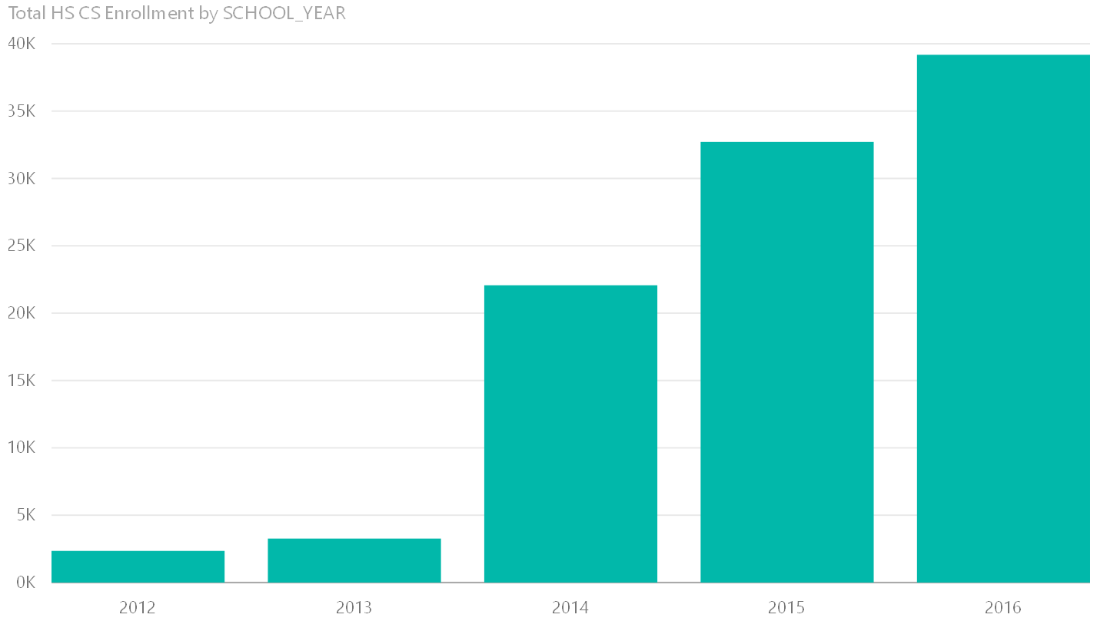
Notes:
Total enrollment in CS related courses in Georgia since 2013.

Slide 21
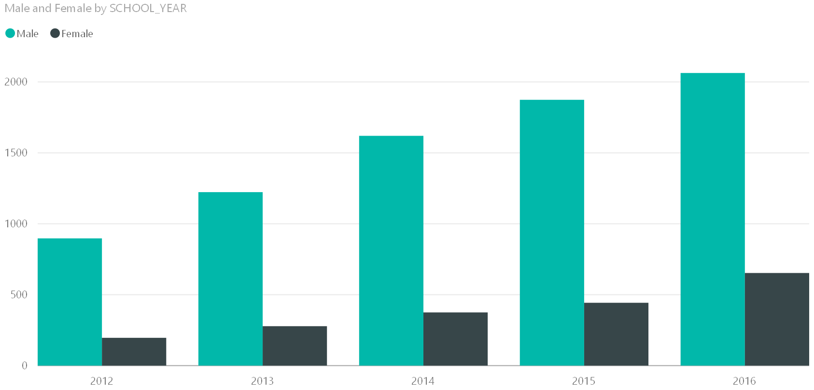
AP Computer Science A in Georgia
Notes:
This course has historically been the benchmark for the growth of computer science in k12 education. We’ve seen growth in the number of girls involved but we’ve still got work to do. This is the motivation for moving CS exposure to the lower grades. By the time students get to high school, they are already self selecting out of CS courses.

Slide 22
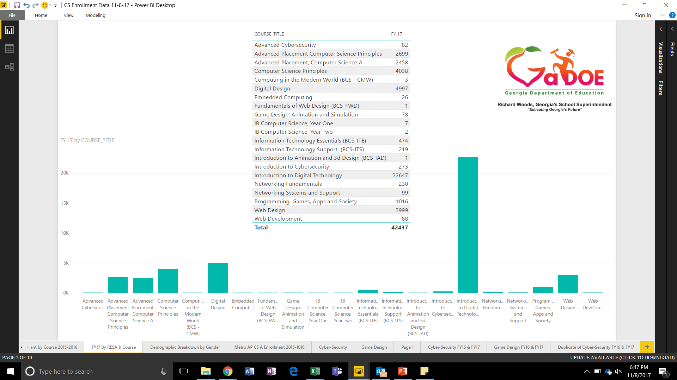
CS Enrollment by Course
FY17
Notes:
This is a breakdown of enrollment by course in Georgia high schools.

Slide 23
Computer Science Needs…
Notes:
These are the things the discipline needs to in order to become a strong integral component of our k-12 curriculum, changing Georgia into a strong IT and CS state.

Slide 24
Resources
Teachers
Access
Nearly 50,000 students taking computer science courses in GA
500+ teachers teaching CS courses in GA
Only 33 teachers were certified in 2016; 76 teachers credentialed in 2017
Teachers need professional development to prepare for the GACE or scholarships for the Endorsement (3k – 4k per teacher).
Principals and superintendents say the main reason their schools do not offer computer science is the limited time they have to devote to classes that are not tied to testing requirements and the low availability and budget for computer science teachers. (Google, Gallup 2015)
Many students do not have access to computer science learning opportunities at school, with lower-income students and Black students having the least access (Google, Gallup 2015).

Slide 25
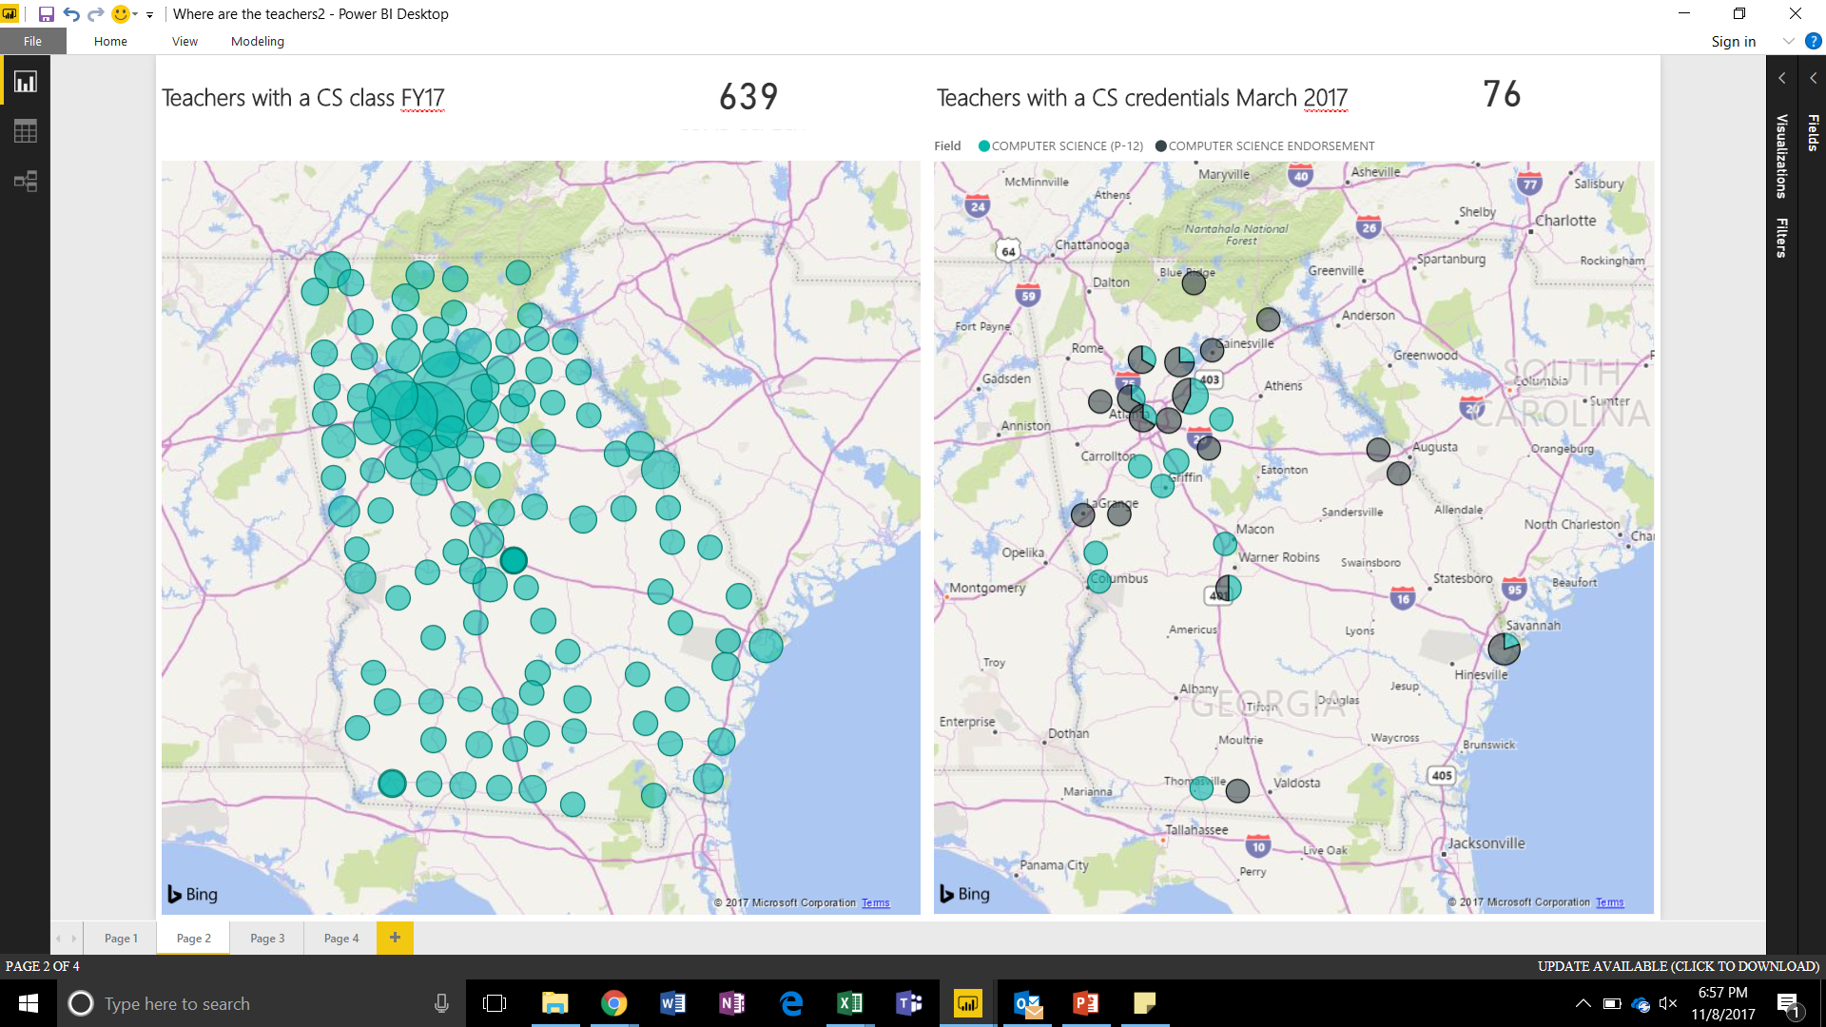

Slide 26
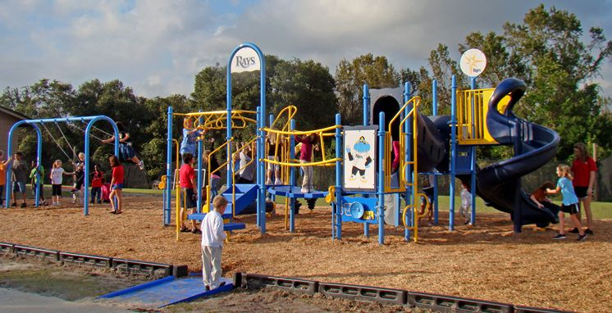
Structure
K-12 Standards for Computer Science will provide a framework for teachers. Grade bands are aligned with appropriate curriculum, concepts and practices so students will develop through a research based progression.
Notes:
We at the DOE are beginning the process of creating K-8 state CS standards.

Slide 27
Nurturing
Computer science Expo to expand public awareness of what computer science is and the wide breadth of utility in society.
Increase counselors and administrators awareness of science graduation options (9 CS courses).
Parents, students, and admins awareness of curriculum options (online, offline, unplugged and out-of-school) to support current teachers, new teachers and supplement a lack of a computer science teachers (particularly in rural or low socioeconomic schools).
Introduce computational thinking into elementary schools via organized specials courses or integration into current curriculum.

Slide 28
How To

Slide 29
Federal Funds
LEAs may choose to use some of their Federal Funds to support CS education (Title I, Title II, Title III, Title IV, Title V and Title IX).
All LEAs won’t use each of these due to different focuses and district plans.
In Georgia, districts have been given the leverage to roll title funds into one pot and some districts have done that.
All federal fund spending must be reflective of the district’s needs assessment and must be supplemental

Slide 30
Professional Development
Title II funds could be used to reduce class size
More likely, however, they can be used to build teacher capacity
Sending teachers to PD opportunities
Establishing a scholarship for teachers to get the CS Endoresement
Line of contact for how to access and use these funds would be your Title II state coordinator

Slide 31
I, III, and V
Title I is to support disadvantaged and at risk students
Title III is to support English Language Learners
Title V is to support rural student education
All of these groups need access to high quality CS education in order to be competitive in today’s society

Slide 32
Title IV
Part B is for 21st Century School Programs which has a strong technology component
Part A contains a requirement for ‘building technology infrastructure’
Staff capacity
Student access
Parent access
These funds can be earmarked for students that need enrichment. All students need CS enrichment

Slide 33
Additional Points of Address

Slide 34
CS vs. CT
What is the difference between Computer Science and Computational Thinking?
Notes:
Computer Science is the study of computing devices and their application in and affect on society. Computational thinking is an approach to problem solving that pulls from the perspective of a computer scientist. This includes decomposition, pattern matching, abstraction, and algorithmic thinking. Computational thinking is often applied to analog challenges in life as well as digital.

Slide 35
Access vs. Exposure
Do we want to ensure all students have access or all students have exposure?
Notes:
Should all students have access to computational thinking and computer science curriculum or should they have mandated computer science experiences? Does the answer to this question change based on grade band?

Slide 36
Increase Teacher Credentialing
Currently only 33 teachers had CS Certification or Endorsement in 2015-2016 while 50,000 students are taking CS courses in high school.
Notes:
We need more certified teachers. We need an initial teaching program. We need help preparing current CS teachers to take the GACE.

Slide 37
Teacher Efficacy
Notes:
We must demystify computer science until it becomes as integral a part of the curriculum as reading, writing, and arithmetic. We actually need to demystify arithmetic as well (contrary to popular belief, everybody is a math person).

