Slide 1

Policies and Procedures
Tiffany Kesslar, Esq.
Brustein & Manasevit, PLLC
tkesslar@bruman.com
www.bruman.com
February 2018

Slide 2
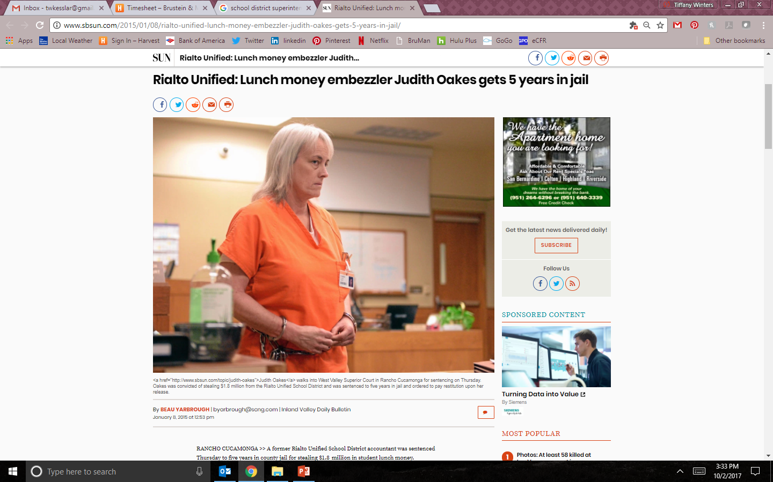
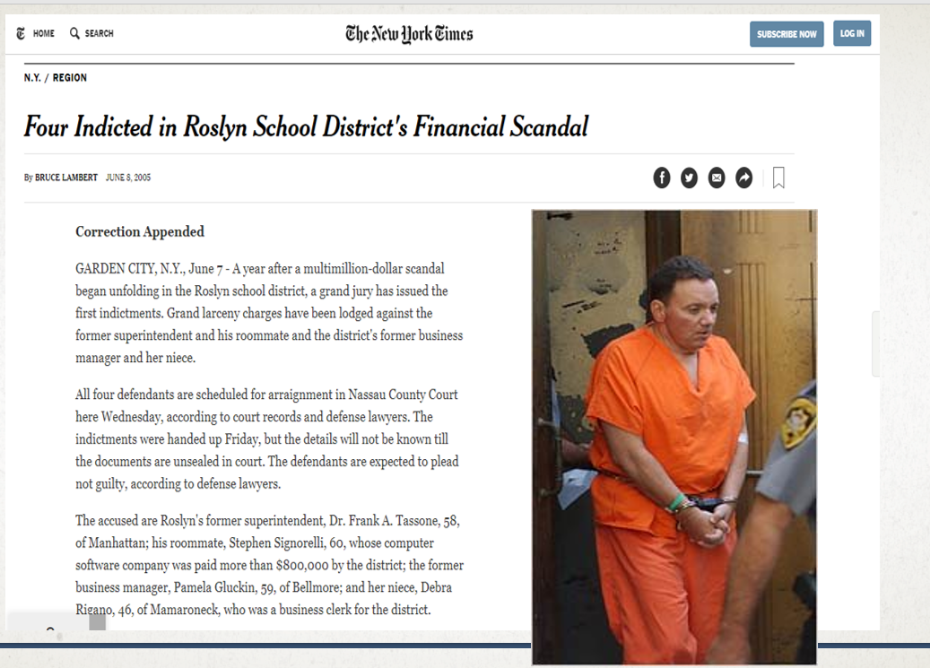
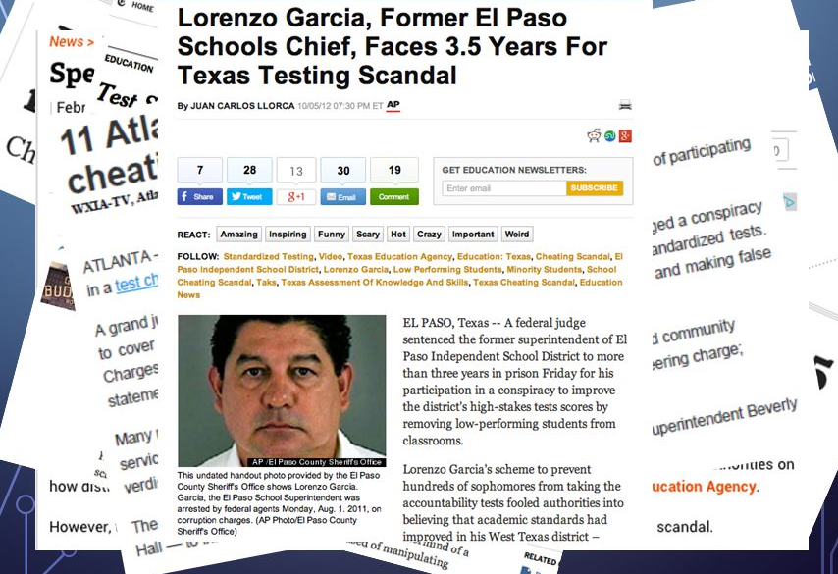
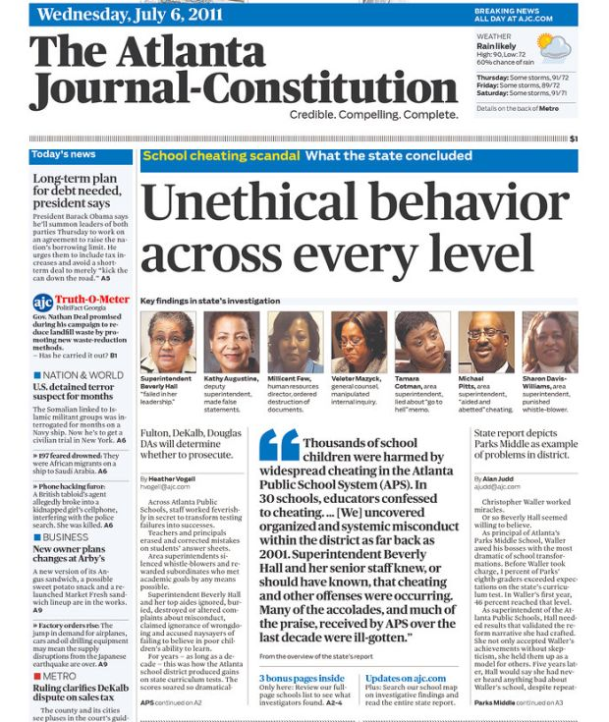
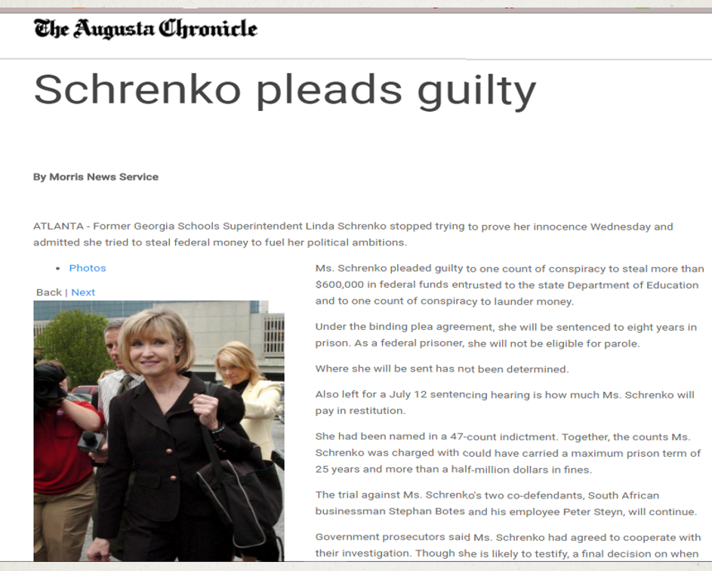
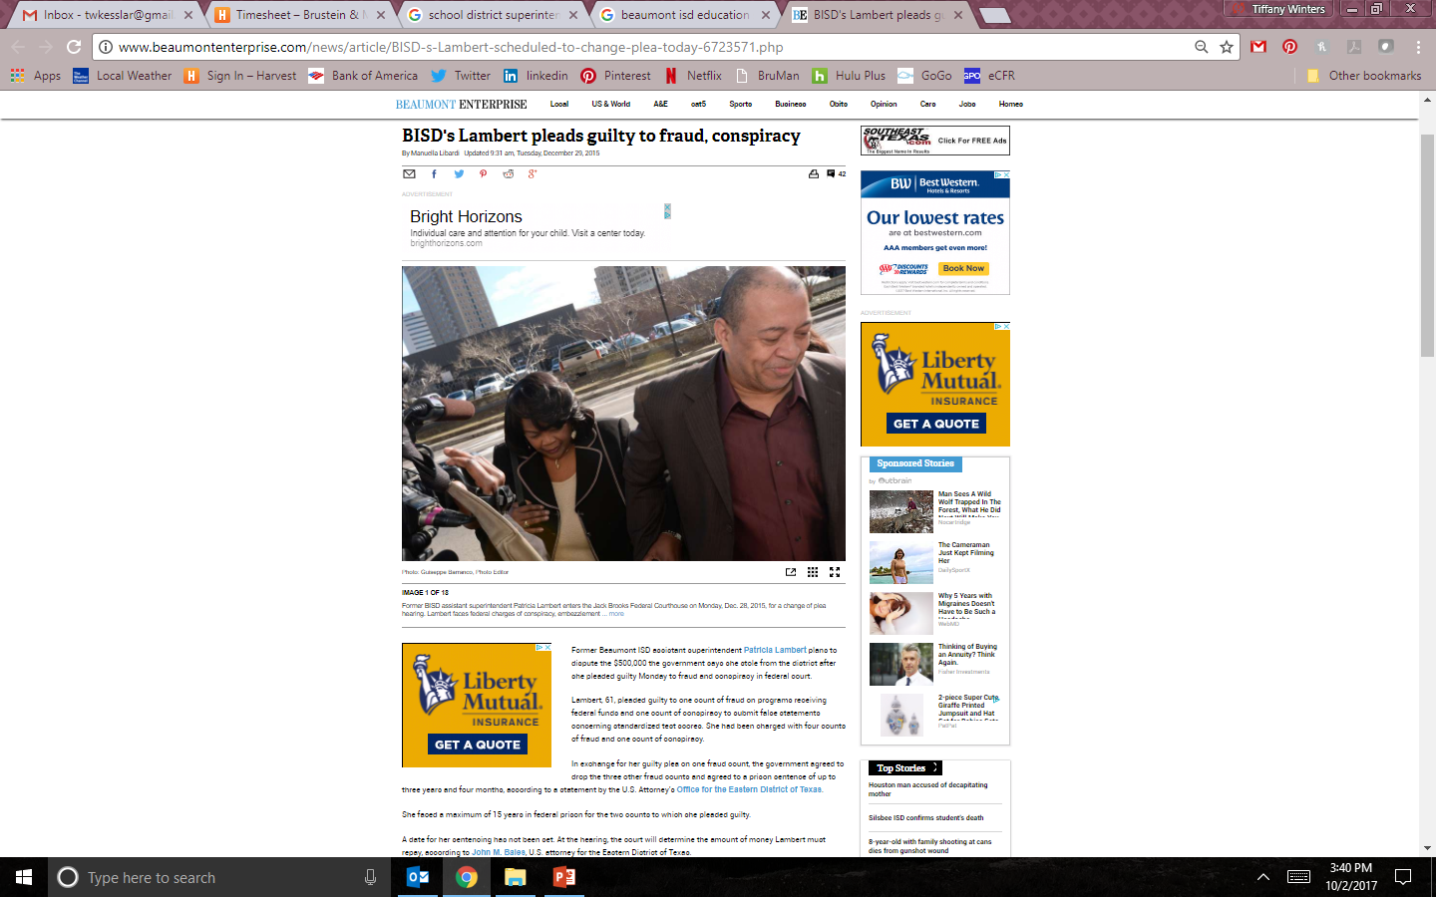
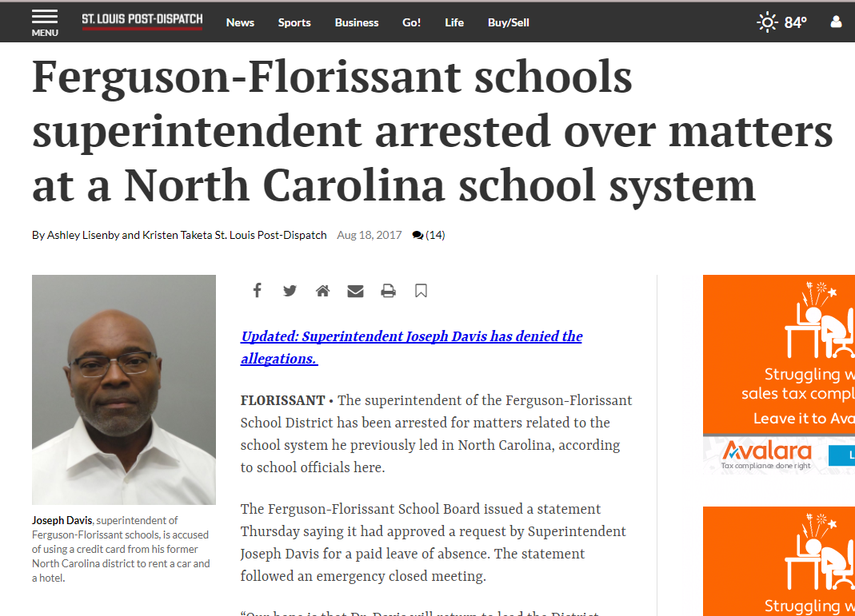
In the News
Notes:
Rosslyn – fraud scheme involving Superintendent to auditors! Conflicts of interest, Bribery, etc.
Georgia – Superintendent stole more than $600,000 funds from the Education Department
St. Louis (Fergueson) – used District credit cards for personal purchases (rental cars, hotels)Atlanta – Test Cheating Scandal.
El Paso – Rigged test scores by removing low performing students from classrooms (Conspiracy involved Assist Super, Principal and Assist Principal of a HS).
San Diego (Sweetwater) - 15 people indicted in 2012 for a "pay-to-play" culture between contractors and officials from three school districts where public officials regularly accepted bribes — trips, dinners and tickets — in exchange for their votes on multimillion-dollar construction projects.
Rialto – Accountant Stole $1.8M school lunch money (worked 25 years) - surveillance videos showed her putting cash into her bra. “She lived a lavish lifestyle,” “$10,000- to $12,000-a-month payments to a credit card, high-end clothing purchases, expensive toys, exotic vacation trips with family as well as a companion.” When police officers searched her home, they found bundles of cash, bound in Rialto Unified money bands. Large deposits had also been made to her personal bank account.
Beaumont - $4M wire transfers

Slide 3

Internal Controls
Back to Basics

Slide 4

KEEP IT SIMPLE!!

Slide 5
S – chedule time to focus on compliance (Control
environment)
I – nform staff changes (Information and
Communications)
M – ake sure to identify trouble areas (Risk analysis)
P – rioritize and improve weaknesses(Control activities)
L – earn the law
E – nforce the requirements (Monitoring)

Slide 6

Documentation

Slide 7
Allowability Documentation
EDGAR – 2 CFR 200.403(g)
To meet allowability requirements… costs must be adequately documented.
EDGAR – 76.730 – 76.731
Shall keep records to show compliance with program requirements.
  The amount of funds;
  How funds were used;
  Total cost of the project;
  Share of the cost provided from other sources; and
  Other records to facilitate an effective audit.

Slide 8
How Long?
Retention Requirements For Records
EDGAR – 2 CFR 200.333
Financial records, supporting documents, statistical records, and all other non-Federal entity records pertinent to a Federal award must be retained for a period of three years from the date of submission of the final expenditure report.
BUT, need to keep records for 5 years because…

Slide 9
How Long? (cont.)
GEPA - Statute of Limitations
34 CFR 81.31(c)
No recipient under an applicable program shall be liable to return funds which were expended in a manner not authorized by law more than 5 years before the recipient received written notice of a preliminary departmental decision.
Case law established that the 5 year statute of limitations period ran from the date of obligation. (Appeal of the State of Michigan)

Slide 10

Know Where your Documents Are!

Slide 11
How Maintain Documentation?
When original records are electronic and cannot be altered, there is no need to create and retain paper copies. (UGG Section 200.335)
When original records are paper, electronic versions may be substituted through the use of duplication or other forms of electronic media provided they:
  Are subject to periodic quality control reviews;
  Provide reasonable safeguards against alteration; and
  Remain readable.

Slide 12

Documentation HOT BUTTON Issues
Are records kept by school, grant, fiscal year?
Do you backup documentation?
  Where and how often?
What happens when staff retire or voluntarily leave?
What happens when staff are fired?
What happens when a school closes?
Staff keep documentation at home?

Slide 13


Slide 14

Policies vs. Procedures
Policies – goals for your organization
Procedures – steps to achieve your goals

Slide 15
Required Policies and Procedures
Written Cash Management Procedure – UGG Sections 200.302(b)(6) and 200.305.
Written Allowability Procedures - UGG Section 200.302(b)(7)
Written Conflicts of Interest Policy - UGG Section 200.318(c)
Written Procurement Procedures - UGG Section 200.319(c)
Written Method for Conducting Technical Evaluations of Proposals and Selecting Recipients - UGG Section 200.320(d)(3)
Written Travel Policy - UGG Section 200.474(b)
**Procedures for managing equipment - UGG Section 200.313(d)

Slide 16
ED’s Cost Allocation Guide:
Time and Effort
“Written policies and procedures are essential to implementing an effective time reporting system.”
Should cover:
(1) the completion of time and attendance reporting;
(2) the approval cycle that is required;
(3) the processing of personnel charges to federal awards; and
(4) the internal review process that will be established to ensure effective internal control over the Federal award.
Time spent → time recorded → time charged

Slide 17
Not only Required, but…
Staff Training
  Training tool and maintains consistency
Compliance Supplement, Part 6: Internal Controls
  “Control activities are the policies and procedures that help ensure the management’s directives are carried out.”
    Clearly written and communicated
Policies and procedures are evidence of compliance under all program monitoring tools
  E.g., OSS Fiscal and Program Administration Self-Assessment → asks for 26 different policies and procedures

Slide 18


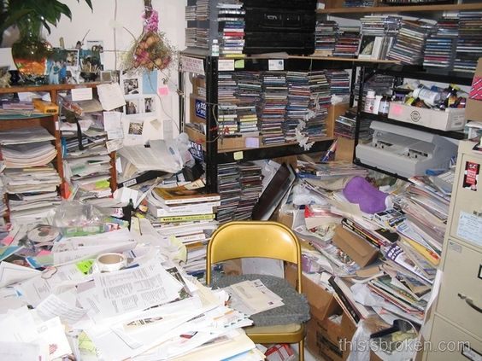

QUICK…WHERE ARE YOUR POLICIES AND PROCEDURES!?!
Notes:
Current Status?
No policies and procedures?
Some policies and procedures?
Existing policies and procedures need updating?
Started updating existing policies and procedures, but got sidetracked… ??

Slide 19

Moving toward Best Practice

Slide 20
Where to Start?
Determine goal
  Internal for your own organization?
  Grant specific or cross cutting?
Create a team – include both fiscal and programmatic personnel (very important)
Create a table of contents
Assign subjects
Create timeline for completion

Slide 21

Policy and Procedures Suggested Sections
Organization, Structure and Function
Grant Application Process
Financial Management System
Allowability
  Specific Items of Cost (Time and Effort, Travel)
Procurement
Inventory/Property Management
Record Keeping/Record Retention
Monitoring and Audit Resolution
Programmatic Requirements
Notice of Nondiscrimination and Grievance Procedures

Slide 22
Where to Start?
Review & collect existing documentation
  Policies & procedures from different offices and websites
  Memos
  Emails
  Forms
  Job descriptions
Directly from the source – the staff member(s)

Slide 23

Who should be involved?
  Fiscal AND program staff
Use team approach to capture entire grant process
  Everyone involved should sit in the same room to review grant activities, decision making, job responsibilities, etc.

Slide 24
How long does it take?
  Depends on need
  Review of existing policies and procedures is less time than starting from scratch
  Set deadlines for actions
  Don’t get overwhelmed!

Slide 25

Things to consider:
Buy-in from those who will be using the policies and procedures
Review for accuracy, completeness and compliance
Adoption by board or other governing body

Slide 26
Key Resources
Uniform Grant Guidance
Education Department General Administrative Regulations (EDGAR)
Authorizing statute
Program regulations
Program guidance
State and agency rules, regulations, policies and procedures

Slide 27

Hot Button Issues

Slide 28

The UGG’ly Truth about Allowability

Slide 29

Allowability
All costs must be necessary and reasonable for the performance of the Federal award and be allocable. UGG Section 200.403(a)

Slide 30
Necessary
Is the cost included in your plan?
Is it aligned with the goals of the district/school?
Does your district/school have the capacity to use what you are purchasing?
Is the staff knowledgeable regarding the program?

Slide 31

Reasonable
Did you pay a fair price? (UGG Section 200.404)
Was competitive procurement used? (UGG Section 200.319)
If sole sourced, what was the reasoning? (UGG Section 200.320(f))
  Public emergency?
  Permitted by USDE/SEA?
  No competition?
  Only vendor in the world?

Slide 32
Allocable
Do you have enough time to implement the cost? (UGG Section 200.405)
Is the program that bought the product using it?
Is the program sharing the use of the item(s)?
  If so, how are costs being shared?
How is the use being documented?

Slide 33

Policy HOT BUTTON Issues
Travel Costs (UGG Section 200.474)
  Does your agency require documentation that participation of individual in a conference is necessary for the program?
  Do you charge travel on actual costs or use a per diem rate?
  Are there written travel reimbursement requirements?

Slide 34

Procurement

Slide 35

Procurement Sections
Open competition
Conflict of Interest
Solicitation
Cost/Price Analysis
Vendor Selection
P-Cards
Required Contract Provisions
Contract Administration
Protest
Procedures

Slide 36

Vendor Selection Process § 200.320
Method of procurement:
  Micro-purchase
  Small purchase procedures
  Competitive sealed bids
  Competitive proposals
  Noncompetitive proposals
  2 CFR § 200.320

Slide 37

Policy HOT BUTTON Issues
Vendor Selection Process (UGG Section 200.320)
Are types of procurement identified?
Is sole sourcing only used when allowable?
  The item is only available from a single source;
  There is a public emergency that will not permit delay;
  The Federal awarding agency or pass-through expressly authorizes noncompetitive proposals in response to a written request; or
  After soliciting a number of sources, competition is determined inadequate.

Slide 38
Policy HOT BUTTON Issues
Conflict of Interest (UGG Section 200.318(c)(1))
  How do you define a conflict?
    A conflict of interest arises when any of the following has a financial or other interest in the firm selected for award:
      Employee, officer or agent;
      Any member of that person’s immediate family;
      That person’s partner; and
      An organization which employs, or is about to employ, any of the above or has a financial interest in the firm selected for award.

Slide 39

Policy HOT BUTTON Issues
Gifts and Gratuities (UGG Section 200.318(c)(1))
Rule: Must neither solicit nor accept gratuities, favors, or anything of monetary value from contractors/ subcontractors.
  However, may set standards for situations in which the financial interest is not substantial or the gift is an unsolicited item of nominal value.
Does your agency define a “financial interest that is not substantial” or a “nominal value” for an unsolicited item?

Slide 40
Policy HOT BUTTON Issues
Reporting Conflict of Interest (UGG Section 200.318(c)(1))
  Is there a chain for reporting potential conflicts?
    Alternative if reporting to employee involved in potential conflict?
  What happens if there is a reported and/or nonreported conflict?
    Recusal
    Sanctions
  How do staff know about the requirements?
    Signed certification that employee received and understands conflicts policy
    Training on policy

Slide 41

Policy HOT BUTTON Issues
Contract Administration (UGG Section 200.318)
How is your agency maintaining oversight to ensure that contractors perform in accordance with the terms, conditions, and specifications of the contract?

Slide 42
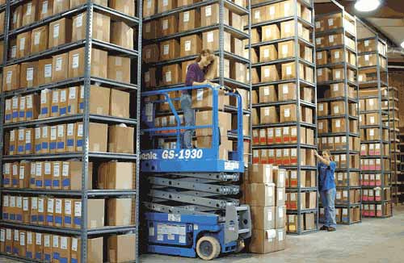
iNVENTORY

Slide 43
Inventory Procedure
Property Defined? (Equipment v. Supplies, etc.)
Where is new inventory received? Check for good condition?
  Receiving report / inventory logged into system
What property is tagged? (By position /office)
  Controls for computing devices?
Physical Inventory
Maintenance
  Process when inventory is lost, stolen or broken?
Disposition / Replacement

Slide 44
Inventory Records
§ 200.313(d)(1)
Serial number or other identification number;
Source of funding for the property;
Who holds title;
Acquisition date and cost of the property;
Percentage of federal participation in the project costs for the federal award under which the property was acquired;
Location, use and condition of the property; and
Any ultimate disposition data including the date of disposal and sale price of the property.

Slide 45
Use of Equipment
§ 200.313(c)(1) and (2)
Equipment must be used by the Non-Federal entity in the program or project for which it was acquired as long as needed, whether or not the project or program continues to be supported by the Federal award.
When no longer needed, may be used in other activities with the following priority:
  Projects supported by Federal awarding agency
  Project funded by other Federal agencies
When used it may be shared (according to the above priorities) provided such use will not interfere with work on the original projects/programs.
Exception – Private Schools 76.661

Slide 46

Policy HOT BUTTON Issues
Regardless of cost, grantee must maintain effective control and “safeguard all assets and assure that they are used solely for authorized purposes.” (UGG Section 200.302(b)(4))

Slide 47
Policy and Procedures Follow-up
Make sure policies and procedures are easy to use and easy to find!
Annual training
Training for new staff
Review and revise annually

Slide 48


Slide 49
Disclaimer
This presentation is intended solely to provide general information and does not constitute legal advice or a legal service. This presentation does not create a client-lawyer relationship with Brustein & Manasevit, PLLC and, therefore, carries none of the protections under the D.C. Rules of Professional Conduct. Attendance at this presentation, a later review of any printed or electronic materials, or any follow-up questions or communications arising out of this presentation with any attorney at Brustein & Manasevit, PLLC does not create an attorney-client relationship with Brustein & Manasevit, PLLC. You should not take any action based upon any information in this presentation without first consulting legal counsel familiar with your particular circumstances.

